Slide 1
EE414 Term Project
Ahmet Emre Eser
Sena Güneş Şirinler

Slide 2
Network Topologies
Section A: Point-to-Point Network
Section B: LAN Configuration
Three-node configuration with controlled traffic generation
Systematic load variation from 1 Mbps to 10 Mbps
Analysis of throughput and delay metrics
Extended topology with multiple nodes and a router
Implementation of TCP NewReno and TCP Vegas
Load variation from 10 Mbps to 100 Mbps
Comprehensive analysis of throughput, delay, and packet loss

Slide 3
Section A: Point-to-Point Network:
Experimental Setup
Network topology: Three-node configuration (Node A → Router B → Node C)
Link characteristics:
Data rate: 5 Mbps
Link delay: 2 ms
Packet size: 1024 bytes
Load variation: 1 Mbps to 10 Mbps in 1 Mbps increments

Slide 4
Section A: Point-to-Point Network:
Results

Slide 5
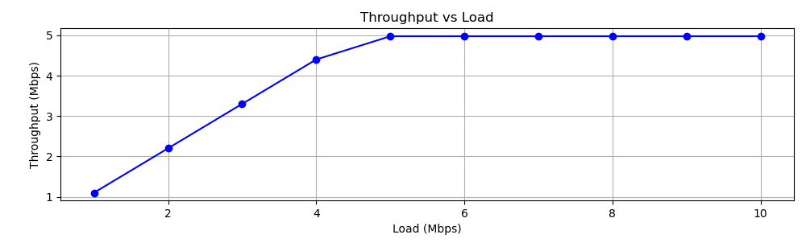
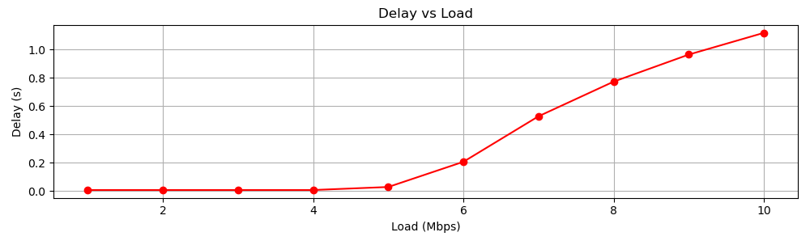
Results
Load (Mbps) | Throughput (Mbps) | Delay (ms)
1 | 1.02751 | 7.3728
2 | 2.05334 | 7.3728
3 | 3.07917 | 7.3728
4 | 4.10499 | 7.3728
5 | 4.98483 | 28.7438
6 | 4.98483 | 206.695
7 | 4.98483 | 528.309
8 | 4.98483 | 773.127
9 | 4.98483 | 964.305
10 | 4.98484 | 1117.91
Fig. 1: Throughput vs Load Graph with UDP
Fig. 2: Delay vs Load Graph for configuration with UDP
Table 1: Metrics obtained for part A. Contents copies from a_metrics.csv file produced by the simulation

Slide 6
Section A: Point-to-Point Network:
Analysis

Slide 7
Point-to-Point Network: Analysis
Throughput Performance
Delay Characteristics (UDP)
The throughput vs. load graph shows three distinct regions:
Linear Growth (1-4 Mbps): Throughput increases linearly with load
Transition (4-5 Mbps): Growth rate decreases as network approaches capacity
Saturation (>5 Mbps): Throughput plateaus at approximately 5 Mbps
The network can handle loads below ~4Mbps comfortably, however channel rate imposes a hard limit on the maximum throughput, as a result network throughput saturates for load values greater than 5Mbps.
TCP Vegas:
Lower average delay (~0.02s)
More consistent delay across loads
Better delay management
TCP NewReno:
Higher average delay (~0.1s)
More variable delay characteristics
Shows sensitivity to load changes

Slide 8
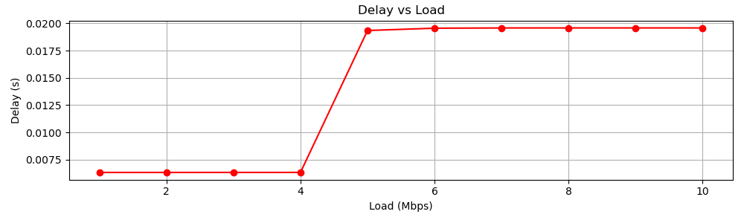
Point-to-Point Network: Analysis
Delay Characteristics (TCP)
The delay vs load graph characteristics show three distinct regions:
Stable Region (1-4 Mbps): For low loads, the delay remains constant and very low (~0 ms).
Sharp Increase (4-5 Mbps): Delay jumps significantly.
Stable Region (>5 Mbps): Delay saturates at approximately 20 ms for higher loads
Fig. 3: Delay vs Load Graph (UDP)

Slide 9
Section B: LAN Configuration
Experimental Setup
Extended topology: LAN (A1, A2, A3) → Router B → Node C
Network parameters:
LAN data rate: 100 Mbps
LAN delay: 1 ms
Packet size: 512 bytes
TCP variants tested: NewReno and Vegas
Load variation: 10 Mbps to 100 Mbps in 10 Mbps increments

Slide 10
Section B: LAN Configuration
Results

Slide 11
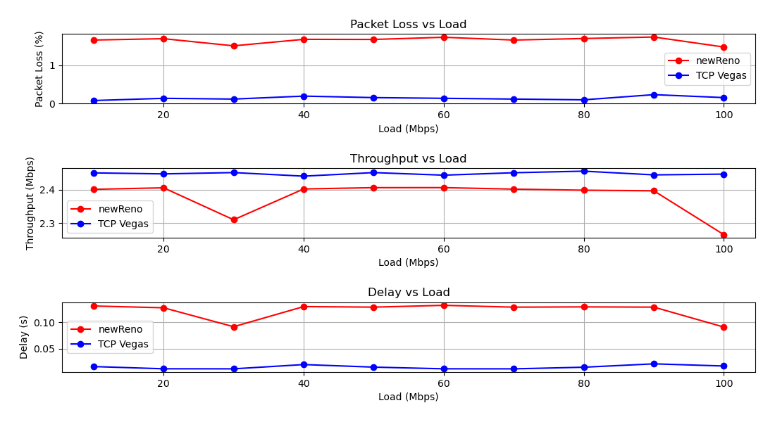
Results
Fig. 4: Packet Loss vs Load Graph
Fig. 5: Throughput vs Load Graph
Fig. 6: Delay vs Load Graph

Slide 12
Results
Load (Mbps) | Throughput (Mbps) | Delay (s) | Packet Loss (%)
10 | 2.40129 | 0.131236 | 1.6548
20 | 2.40589 | 0.127825 | 1.69036
30 | 2.30973 | 0.0917251 | 1.50391
40 | 2.40241 | 0.130096 | 1.67308
50 | 2.40635 | 0.129053 | 1.67019
60 | 2.40641 | 0.132501 | 1.72712
70 | 2.40193 | 0.129021 | 1.65448
80 | 2.39865 | 0.12951 | 1.69459
90 | 2.39676 | 0.129056 | 1.73377
100 | 2.26475 | 0.0910524 | 1.47269
Load (Mbps) | Throughput (Mbps) | Delay (s) | Packet Loss (%)
10 | 2.4508 | 0.0157642 | 0.0766871
20 | 2.44776 | 0.011525 | 0.134305
30 | 2.45171 | 0.0114256 | 0.114943
40 | 2.44094 | 0.0195606 | 0.192308
50 | 2.45167 | 0.014683 | 0.153198
60 | 2.44392 | 0.011493 | 0.134538
70 | 2.45124 | 0.0113961 | 0.114987
80 | 2.45596 | 0.0145081 | 0.0956389
90 | 2.44478 | 0.0209431 | 0.230282
100 | 2.44706 | 0.0167967 | 0.153521
Table 2: Metrics for TCP New Reno. Contents copies from b_metrics.csv file produced by the simulation
Table 3: Metrics for TCP Vegas. Contents copies from b_metrics.csv file produced by the simulation

Slide 13
Section B: LAN Configuration
Analysis

Slide 14
LAN Configuration: Analysis
Throughput Performance
Delay Characteristics
TCP Vegas:
Maintains consistent throughput (~2.45 Mbps)
Shows better stability across different loads
Less variation in performance
TCP NewReno:
Slightly lower average throughput (~2.4 Mbps)
More variable performance
Significant drop at high loads (100 Mbps)
TCP Vegas:
Lower average delay (~0.02s)
More consistent delay across loads
Better delay management
TCP NewReno:
Higher average delay (~0.1s)
More variable delay characteristics
Shows sensitivity to load changes

Slide 15
LAN Configuration: Analysis
Packet Loss
TCP Vegas:
Minimal packet loss (<0.5%)
Consistent performance across loads
Better congestion avoidance
TCP NewReno:
Higher packet loss (~1.5%)
More variable loss characteristics
Reactive rather than proactive congestion control

Slide 16
TCP New Reno and Vegas Comparison and Recommendations
TCP Vegas demonstrates superior performance in this network configuration:
Better stability in throughput
Lower and more consistent delay
Significantly lower packet loss
More efficient congestion management
The proactive approach of TCP Vegas, which uses RTT variations to detect potential congestion, proves more effective than NewReno's reactive loss-based approach. Vegas's ability to maintain stable performance while keeping buffer occupancy low makes it particularly suitable for:
Networks requiring consistent performance
Applications sensitive to delay
Scenarios where packet loss is costly

Slide 17


